Slide 1
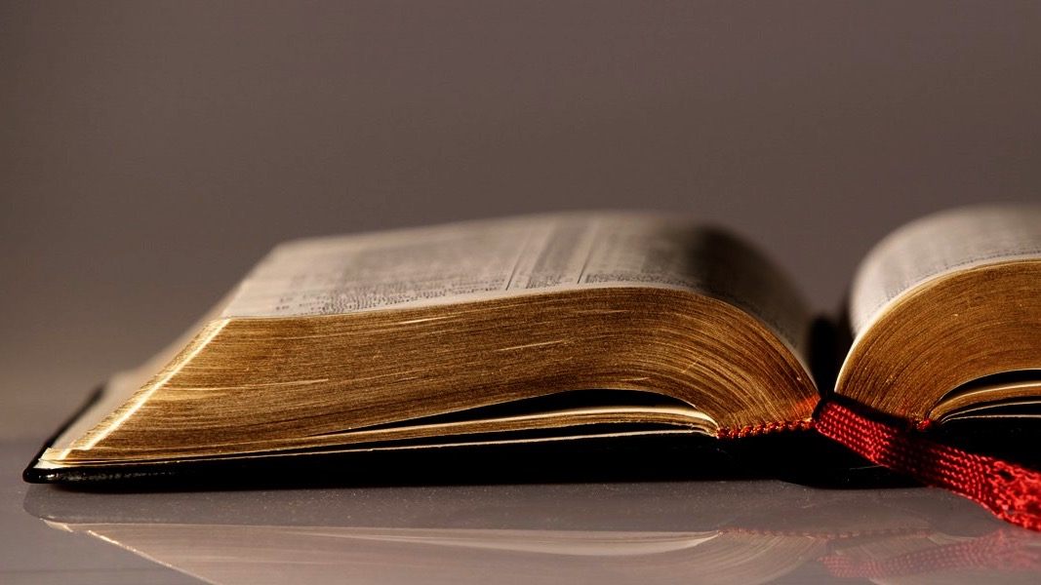
Welcome to
Our Sunday School
We’ll start at 9:07
visit OurSundaySchool.com for more about our class

Slide 2
Ephesians, week 10 (pages 65–74)

Slide 3
Hear: Ephesians 1

Slide 4
Ephesians 1:18-20
so that you—the eyes of your heart having been enlightened—will know what is the hope of His calling, what are the riches of the glory of His inheritance in the saints, and what is the surpassing greatness of His power toward us who believe according to the working of the might of His strength, which He worked in Christ, by raising Him from the dead and seating Him at His right hand in the heavenly places,

Slide 5
Ephesians, week 10 (pages 65–74)

Slide 6
Dr. Bill Klein
“Heart”… refers to the seat of the physical, spiritual, or mental life…. It represents the hub of a person’s being, the foundation of understanding and will, the center of one’s personality.

Slide 7
Ephesians, week 10 (pages 65–74)

Slide 8
Ephesians 1:18-20
1
so that you—the eyes of your heart having been enlightened—will know what is the hope of His calling, what are the riches of the glory of His inheritance in the saints, and what is the surpassing greatness of His power toward us who believe according to the working of the might of His strength, which He worked in Christ, by raising Him from the dead and seating Him at His right hand in the heavenly places,
2
3

Slide 9
Dr. Andrew Lincoln
The three clauses beginning with τίς, τίς, and τί ask for [1] knowledge of the hope God’s calling brings,

Slide 10
Dr. Andrew Lincoln
[2] knowledge of the wealth of glory laid up in his inheritance in the saints, and [3] knowledge of the immensity of his power

Slide 11
Ephesians, week 10 (pages 65–74)

Slide 12
Dr. Frank Thielman
“Hope” does not involve an uncertain expectation that things might turn out well, but a firm conviction, against all appearances to the contrary…

Slide 13
Dr. Frank Thielman
that God will be gracious to his people because of what he has already accomplished for them in Christ

Slide 14
Dr. Harold Hoehner
Hope for believers is not the world’s wishful thinking, but the absolute certainty that God will make true what he has promised

Slide 15
Dr. Tony Merida
When we hold out the gospel to people, we are essentially holding out hope to people

Slide 16
Ephesians, week 10 (pages 65–74)

Slide 17
Dr. Harold Hoehner
Not only do we have an inheritance (v. 14) but he also has an inheritance (vv. 11, 18)

Slide 18
Ephesians, week 10 (pages 65–74)

Slide 19
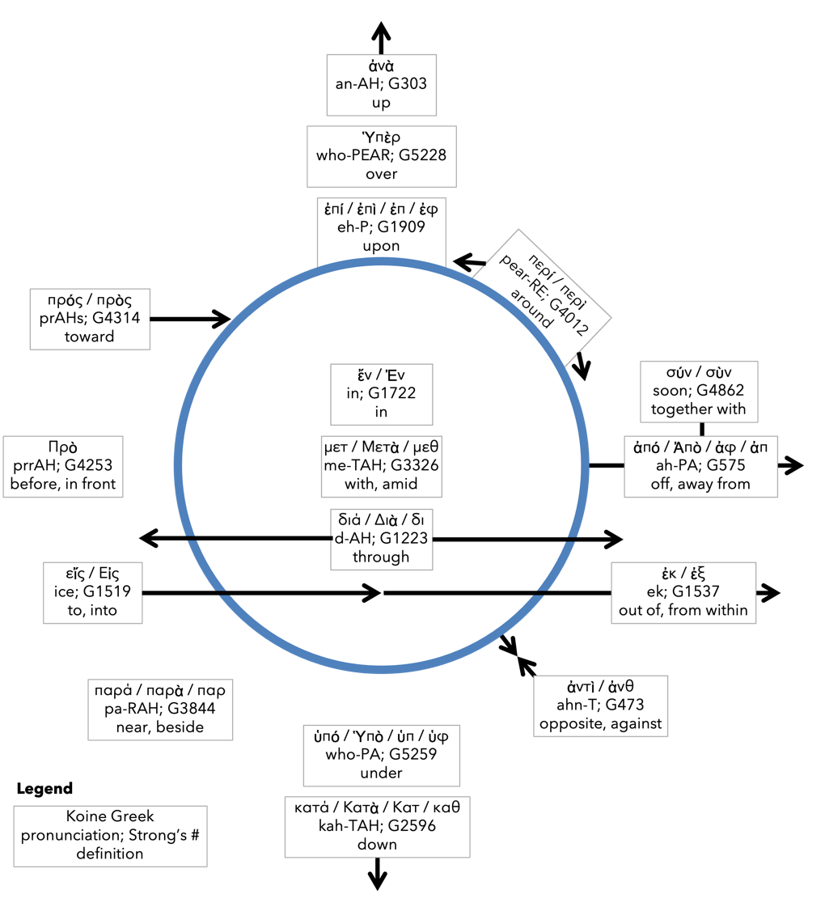
Preposition circle (page 11)

Slide 20
Ephesians, week 10 (pages 65–74)

Slide 21
Dr. Tony Merida
To be at the “right hand” was a position of privilege, honor, favor, victory, and power. This position belongs to Jesus Christ alone.

Slide 22
Ephesians, week 10 (pages 65–74)

Slide 23
Reflection/Journal/Quotes (page 83)
What did God do in me through Ephesians 1?
Were there any significant or impactful commentary quotes from Ephesians 1?

Slide 24
Next time: Ephesians 1:21-23 (pp. 74–82)

Slide 25
Commentaries
Quotes are due to Jim by Thursday night
If you would like one, let Jim know

Slide 26
Prayer time
Write down your prayer requests (on the Weekly Update or in the comments)
Lean in, engage, and pray for someone not with you
Be out of this room by 9:50
Go worship

